Slide 1
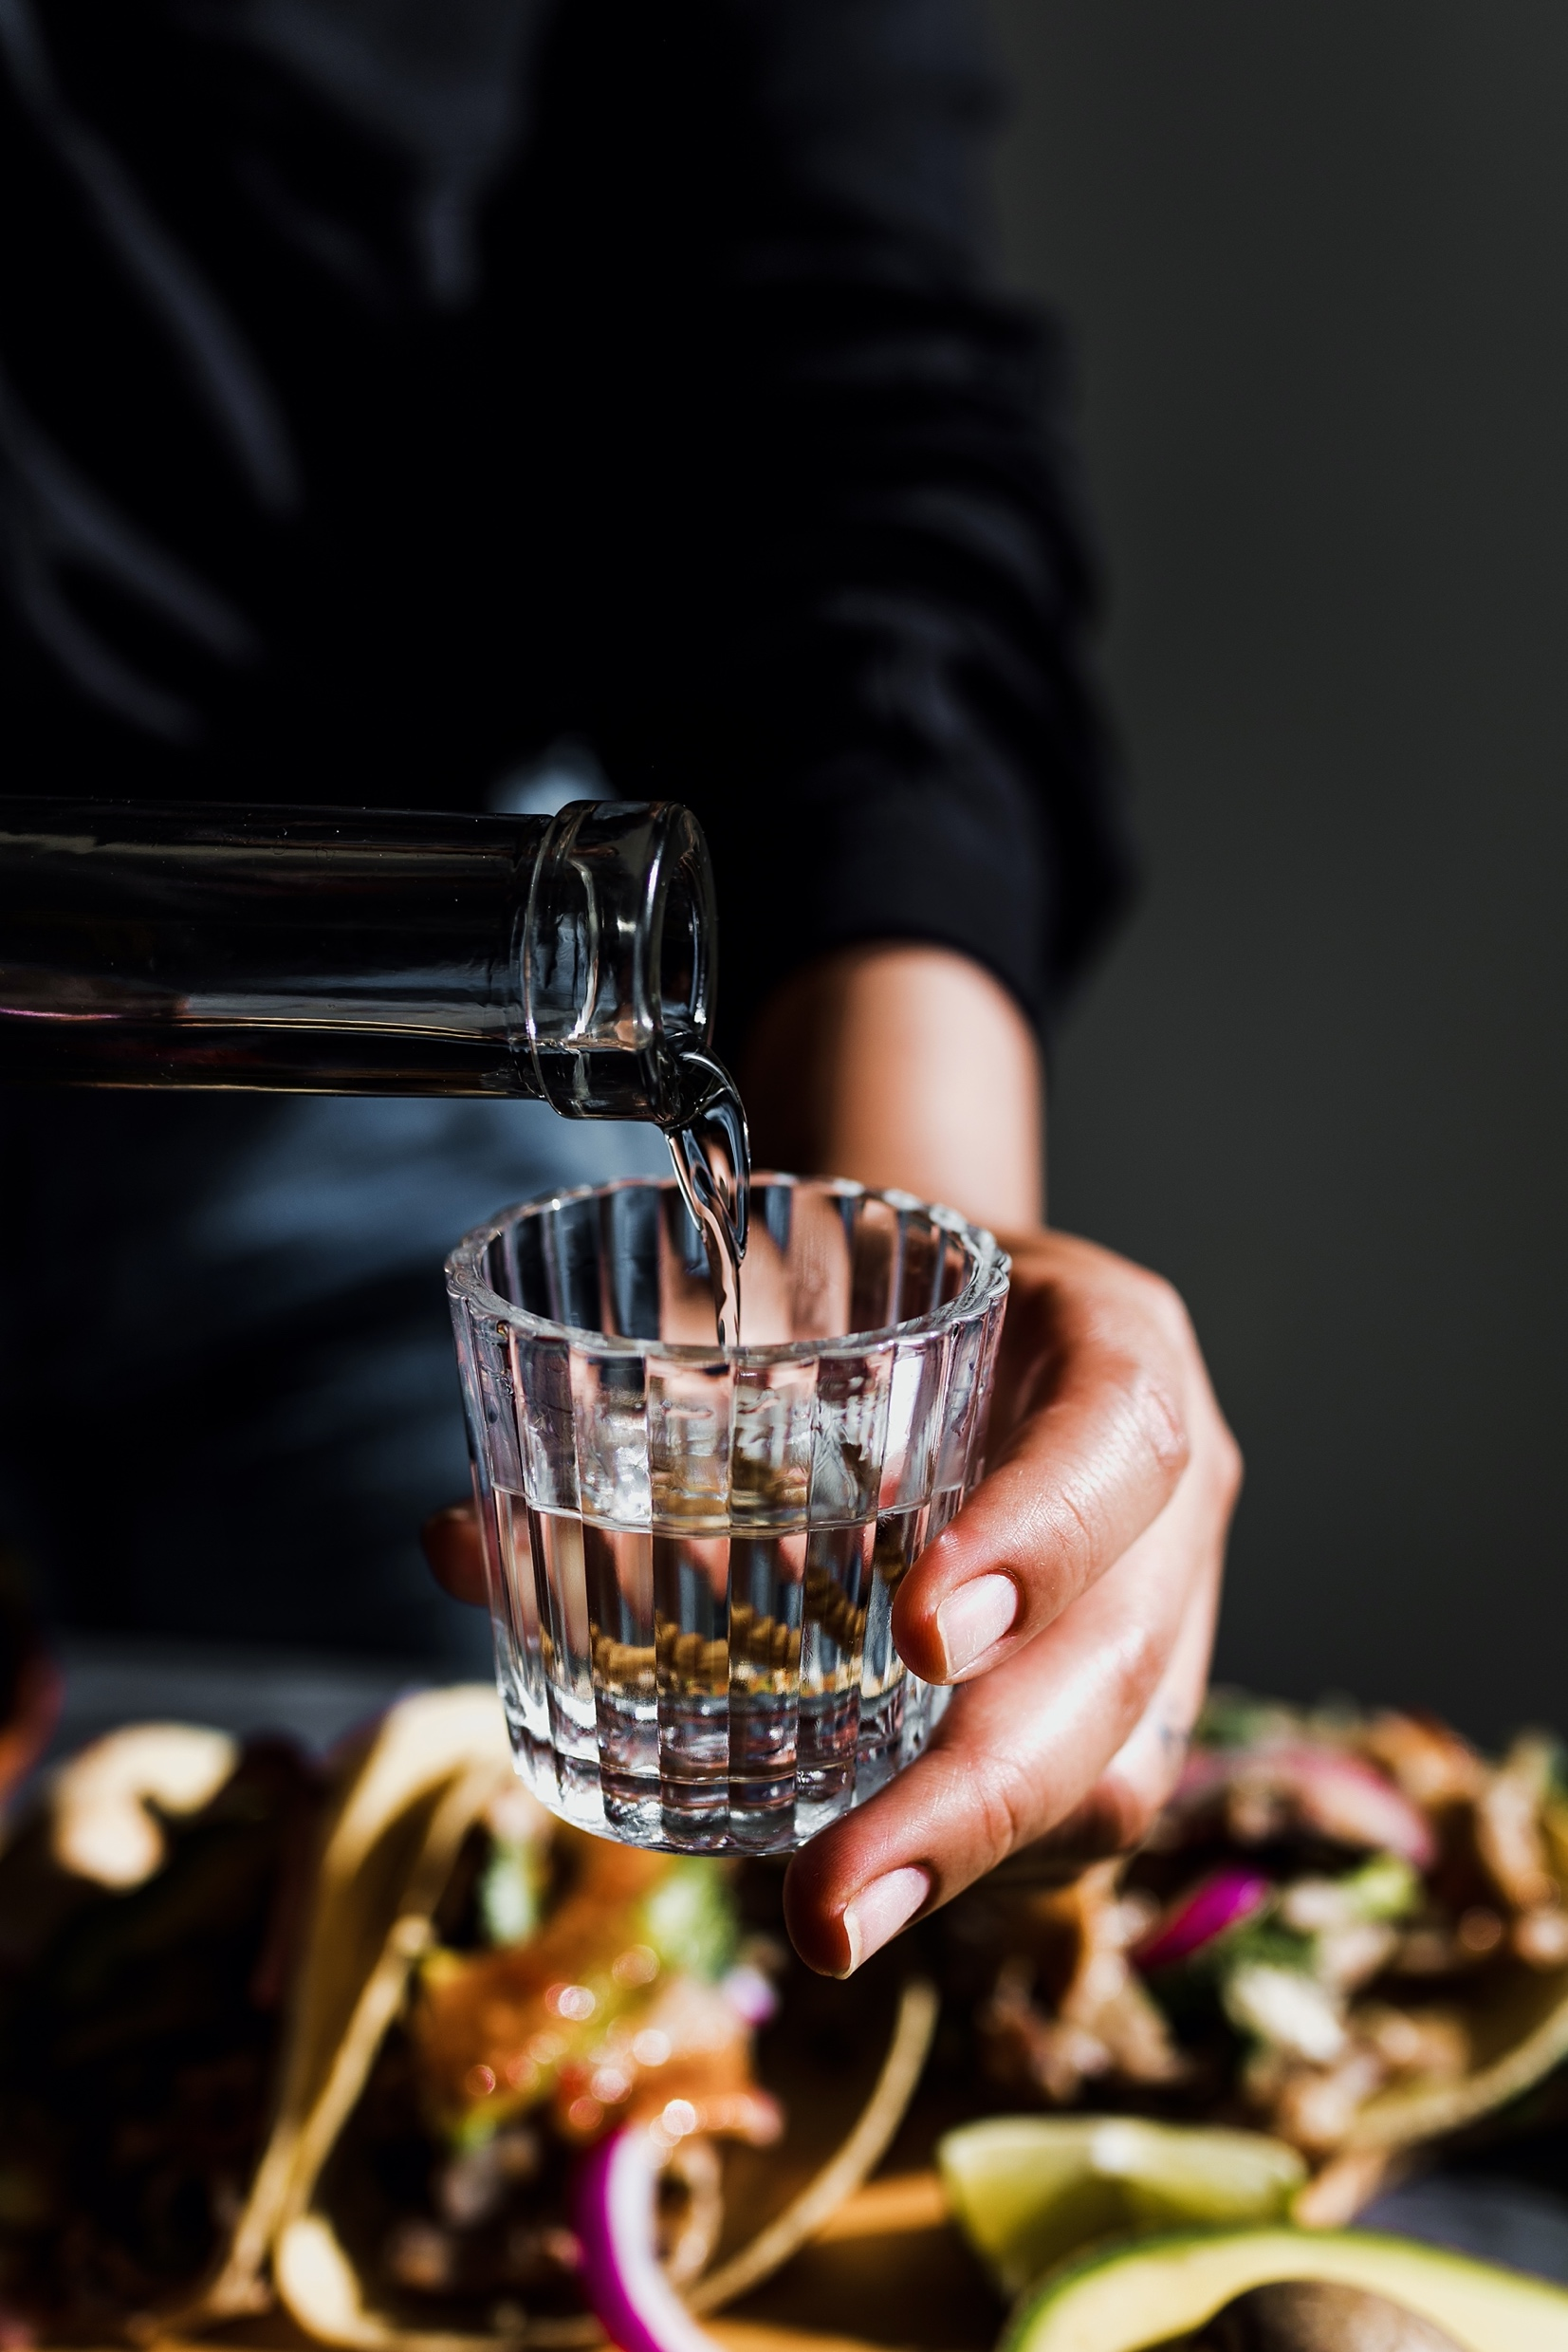
表面1
TORANOMON Corporation
https://www.toranomoncorp.com
JAPANESE LIQUOR CATALOG
The types of liquor we offer are sake, shochu, liqueur and spirits.
©️2022 TORANOMON Corporation. All Rights Reserved.

Slide 2
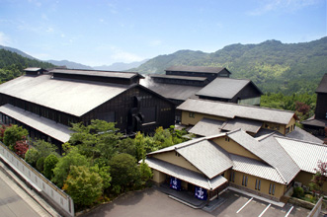
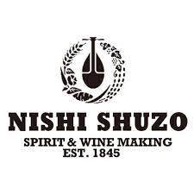
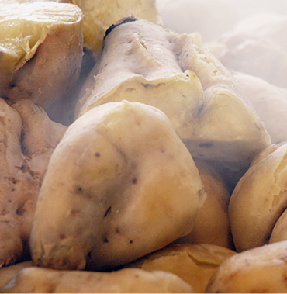
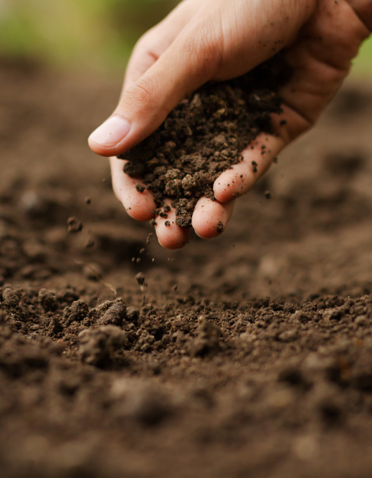
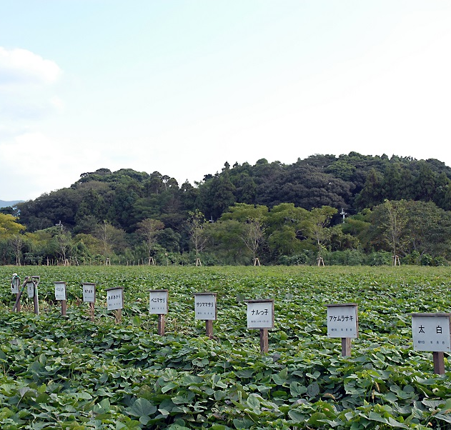
表面2
西酒造株式会社
Long-established 175-year-old distillery
Please enjoy the craftsmanship.
Nishi Shuzo is best known for its line of sweet potato shochu under the brand name Houzan.

Slide 3
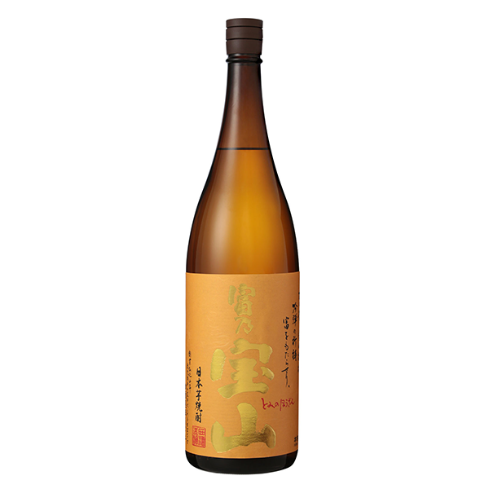
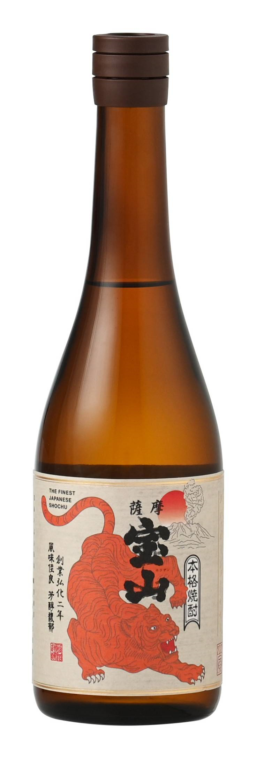
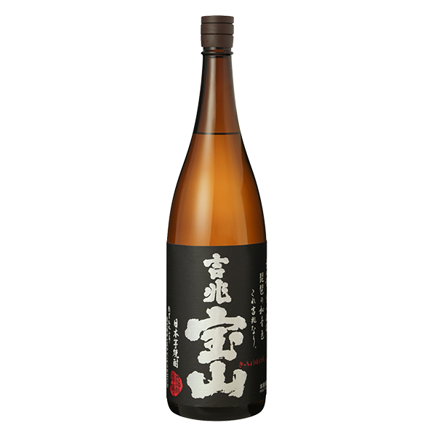
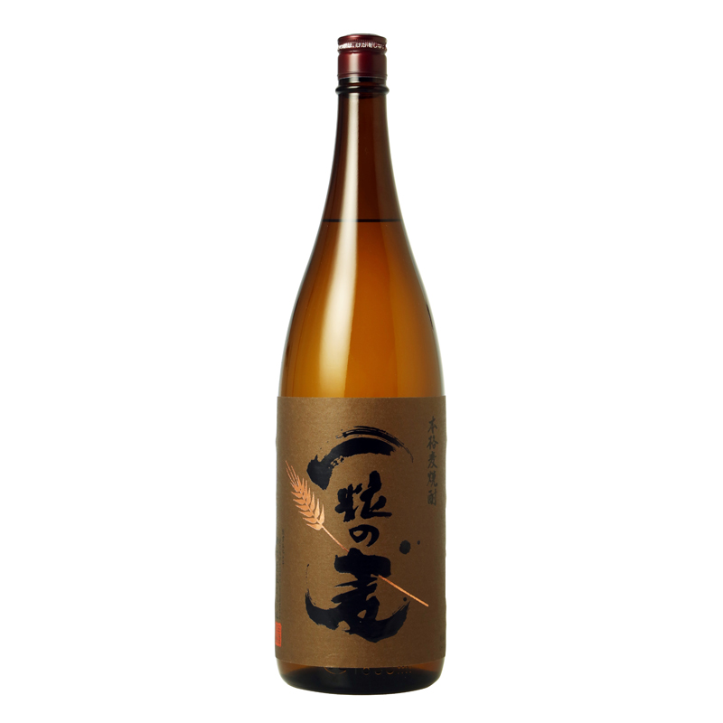
表面2
Shochu
Tomino Houzan
Tomino Houzan 2022 Tiger label
Prepared with yellow jiuqu. The scent of the moment you pour it into the glass is light, and the taste is deep when you take a bite. We carefully polished the carefully selected ”Kogane sengan" and carefully prepared it with low temperature control to open up a new world of Imo Shochu. It is praised for its refreshing citrus aroma and crisp texture. We aimed for shochu that looks good on a quiet bar counter.
・ Alcohol content / 25 degrees ・ Ingredient name / Sweet potato (Kogane sengan from Kagoshima prefecture) ・ Rice Jiuqu (Yellow Jiuqu / Domestic rice) ・ Contents / 1800ml ・ 720ml ・ Distillation method / atmospheric pressure single distillation
Prepared with yellow jiuqu. The scent of the moment you pour it into the glass is light, and the taste is deep when you take a bite. We carefully polished the carefully selected " Kogane sengan " and carefully prepared it with low temperature control to open up a new world of Imo Shochu. It is praised for its refreshing citrus aroma and crisp texture. We aimed for shochu that looks good on a quiet bar counter.
・ Alcohol content / 25 degrees ・ Ingredient name / Sweet potato (Kogane sengan from Kagoshima prefecture) ・ Rice Jiuqu (Yellow Jiuqu / Domestic rice) ・ Contents / ・ 720ml ・ Distillation method / atmospheric pressure single distillation
★Limited label
Kichicho Houzan
Hitotsubu no Mugi
Prepared with black jiuqu. You can enjoy a rich aroma and deep taste when you divide it with hot water. The fragrance that tickles the nose with the steam rising from the glass is as refreshing and refreshing as the aftertaste. This is a deeper version of the royal road of Imo Shochu. First of all, with hot water.
・ Alcohol content / 25 degrees ・ Ingredient name / Sweet potato (Kogane sengan from Kagoshima prefecture) ・ Rice Jiuqu (Black Jiuqu / Domestic rice) ・ Contents / 1800ml ・ 720ml ・ Distillation method / atmospheric pressure single distillation
Light aroma, deep and round taste. The normal pressure indirect distillation cultivated with potatoes brings out the deliciousness of wheat. The standing scent has a sharp impression, and the base scent has the aroma of wheat. It is a popular one for rock and water. There must be a discovery that sets it apart from the barley shochu you know.
・ Alcohol content / 25 degrees ・ Ingredient name / Barley / Barley Jiuqu ・ Contents / 1800ml ・ 720ml ・ Distillation method / atmospheric pressure indirect distillation

Slide 4
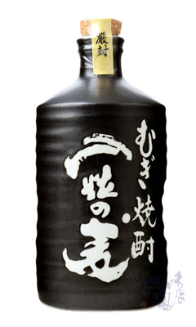
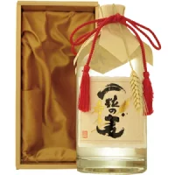
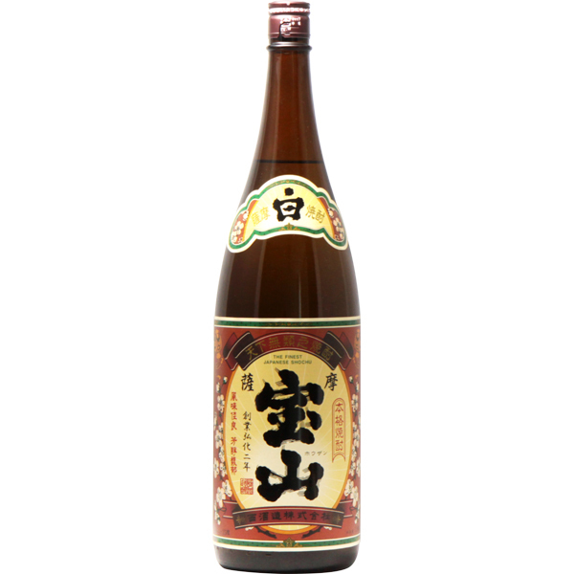
表面2
Shochu
Hitotubu no Mugi Toki Iri
Hitotubu no Mugi (keshōhako)
Light aroma, deep and round taste. The normal pressure indirect distillation cultivated with potatoes brings out the deliciousness of wheat. The standing scent has a sharp impression, and the base scent has the aroma of wheat. It is a popular one for rock and water. There must be a discovery that sets it apart from the barley shochu you know.
There are dents on both sides to make it easier to hold a pottery bottle. It is a gem of barley shochu that is also recommended for drinking at home and keeping bottles at restaurants.
・ Alcohol content / 25 degrees ・ Ingredient name / Barley / Barley Jiuqu ・ Contents / 1800ml ・ 720ml ・ Distillation method / atmospheric pressure indirect distillation
Light aroma, deep and round taste. The normal pressure indirect distillation cultivated with potatoes brings out the deliciousness of wheat. The standing scent has a sharp impression, and the base scent has the aroma of wheat. It is a popular one for rock and water. There must be a discovery that sets it apart from the barley shochu you know.
Suitable for gifts. The paulownia box creates a sense of luxury.
・ Alcohol content / 25 degrees ・ Ingredient name / Barley / Barley Jiuqu ・ Contents / 720ml ・ Distillation method / atmospheric pressure indirect distillation
Satsuma Houzan
Satsuma Houzan kurokoji
It is the origin of all Satsuma Houzan series and is one of the standards of deliciousness.
The comfort of the mouth that makes you feel the roundness while making you feel the potatoes firmly. Since its founding in 1845, Fukiage-cho has continued to maintain its tradition. It is one of the standards of taste of all Houzan series. You can enjoy it slowly with traditional hot water, or you can sip it with a rock, and make a dedication with your own way of drinking.
・ Alcohol content / 25 degrees
・ Ingredient name / Satsuma potato (Kogane sengan from Kagoshima prefecture) ・ Rice koji (white koji / domestic rice)
・ Contents / 1800ml ・ 720ml
・ Distillation method / atmospheric pressure single distillation
The origin of Houzan "Satsuma Houzan", the origin of "black".
It is one that you can feel the spine of Imo shochu.
Unique aroma and rich taste due to the preparation of black jiuqu. It also features a strong aftertaste that does not interfere with the delicate taste of the side dish.
・ Alcohol content / 25 degrees
・ Ingredient name / Satsuma potato (Kogane sengan from Kagoshima prefecture) ・ Rice koji (black koji / domestic rice)
・ Contents / 1800ml ・ 720ml
・ Distillation method / atmospheric pressure single distillation

Slide 5
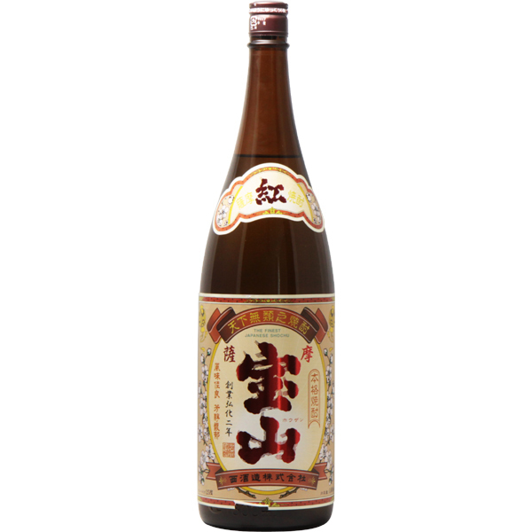
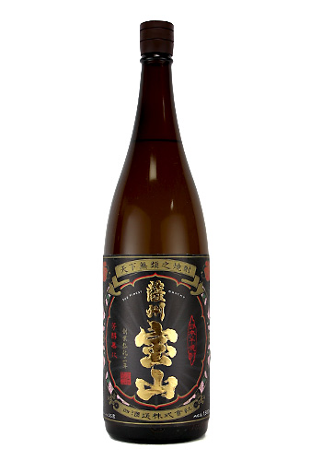
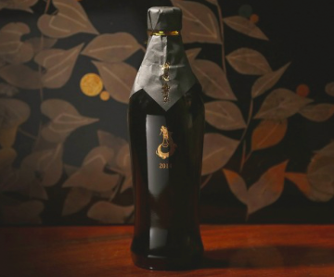
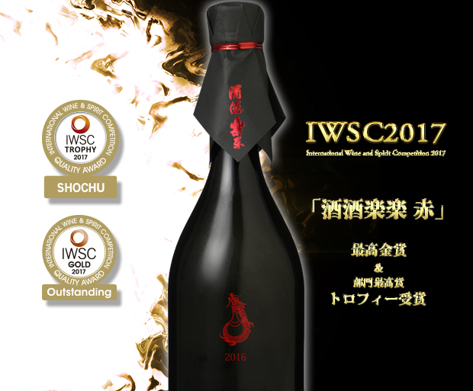
表面2
Shochu
Benai satsuma Houzan
Sasshu Houzan
We use abundant purple potato "Ayamurasaki" and use domestic rice for Jiuqu rice. The flesh color is bright purple, which is the color of anthocyanin, which is a type of polyphenol. Imo-jochu has a gorgeous aroma like wine, a sweet taste, and a sharp aftertaste.
・ Alcohol content / 25 degrees
・ Ingredient name / Ayamurasaki potato (from Kagoshima prefecture) ・ Rice koji (white koji)
・ Contents / 1800ml ・ 720ml
・ Distillation method / atmospheric distillation
The koji ratio was reduced and three-stage preparation was performed, and the slowly fermented mash was finished by atmospheric pressure single distillation. The mellow aroma of potatoes and the rich umami and sweetness of the potatoes spread in the mouth, giving it a mellow taste.
・ Alcohol content / 25 degrees
・ Raw material name / potato “Kogane sengan from Satsuma” ・ Jiuqu
・ Contents / 1800ml ・ 720ml
・ Distillation method / atmospheric pressure single distillation
Grand CruShasharakuraku Gold
Grand Shasharakuraku Red
The gorgeous and bewitching scent of the original sake is retained, but by lowering the frequency, the taste that makes it easier to drink and feels familiar is the sweetness and umami that makes you feel the width while being light, and the refreshing aftertaste makes you feel comfortable and intoxicated. invite. The steaming series emphasizes enjoying as a single sake, but this is a shochu that you can easily enjoy the difference between potatoes with meals.
・ Alcohol content / 30 degrees
・ Raw material name / Raw material: Sweet potato (Kogane sengan), Rice Jiuqu (Yamada Nishiki) Jiuqu: White Jiuqu
・ Contents / 720ml
・ Distillation method / atmospheric distillation
Limited brand of Nishi Sake Brewery, which is made by thoroughly sticking to the quality of raw materials. Using only the Kogane sengan grown in the most soily and sunny special grade field on our farm and the special koji rice as raw materials, the temperature control of the mash is low temperature fermentation according to the special yeast, and the distillation is the atmospheric pressure single distillation method. It is carefully finished with.
・ Alcohol content / 35 degrees
・ Raw material name / Sweet potato (kogane sengan from Kagoshima prefecture) ・ Jiuqu (Yamada Nishiki)
・ Contents / 720ml
・ Distillation method / Low temperature fermentation, distillation is atmospheric pressure single distillation method
★ International Wine & Spirits
Competition 2017 / Highest Gold Award & Best Category Award (VT2016)

Slide 6
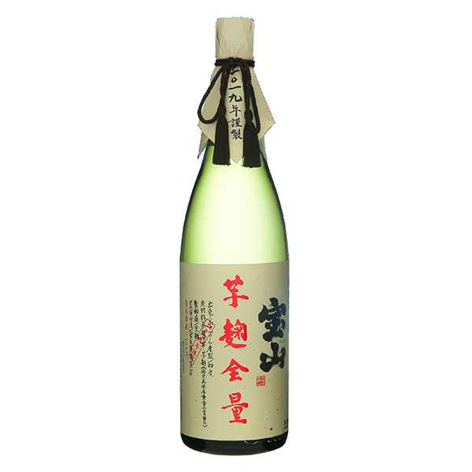
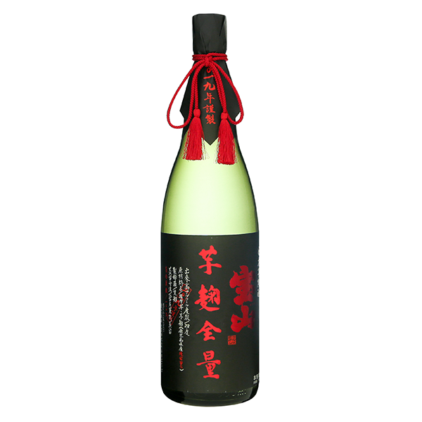
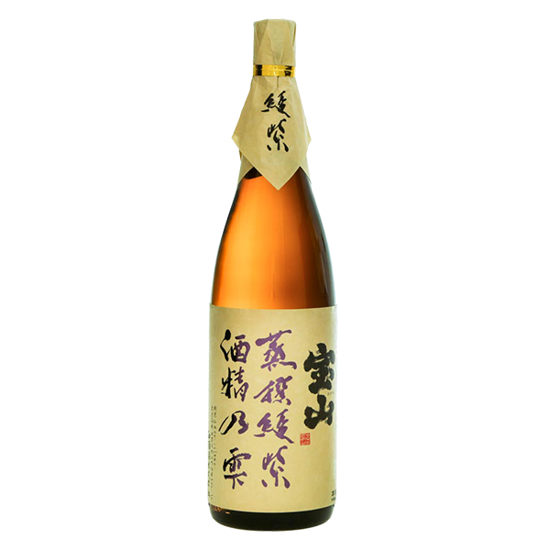
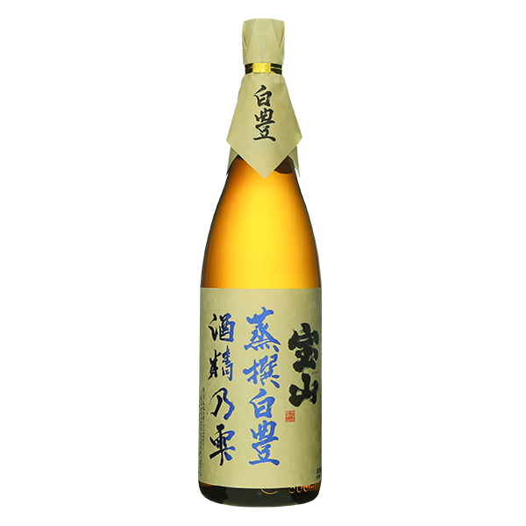
表面2
Shochu
Houzan Imokojizenryo
Houzan Aya murasaki Imokojizenryo
I also used potatoes for the jiuqu, and prepared only 100% potatoes (Kogane sengan). The time spent by Mr. Mori, who spared no effort in delicate preparation, tells us that the potatoes are elegant and fragrant. Please enjoy the special taste of the limited shipment.
・ Alcohol content / volume ・ Raw material name / Sweet potato (Kogane sengan from Kagoshima prefecture) ・ Jiuqu (Jiuqu / Black Jiuqu) ・ Contents / 1800ml ・ Distillation method / atmospheric pressure single distillation <Seasonal>
Made luxuriously using only the potato "Aymurashi", which has a reputation for enjoying a wine-like scent. Of course, Jiuqu is also "Ayamurashi". Along with the unique aroma that drifts from the deep violet mash, the rich taste of potatoes that only the entire amount of potato jiuqu can have has created a new impression.
・ Alcohol content / volume
・ Raw material name / Sweet potato (Aya purple from Kagoshima prefecture) ・ Jiuqu (Jiuqu / Black Jiuqu)
・ Contents / 1800ml
・ Distillation method / atmospheric pressure single distillation <Seasonal>
Houzan Aya Murasaki
Houzan Shiro yutaka
We made Imo Jōchu, which is a kind of polyphenol and contains a lot of anthocyanins, as a raw material to enjoy the gorgeous scent. It is not efficient because it is a potato with low starch quality, but I dared to stick to its characteristics. The aroma has a gorgeous sweetness, and the aftertaste has a sharpness that is not unskilled.
・ Alcohol content / 25 degrees
・ Ingredient name / Sweet potato (Aya murasaki from Kagoshima prefecture)
・ Rice Jiuqu (White Jiuqu / Domestic rice)
・ Specifications / No filtration / No adjustment Direct packing
・ Contents / 1800ml ・ 720ml
・ Distillation method / atmospheric pressure single distillation <Seasonal>
Enjoy the refreshing finish. Therefore, it contains more starch than Kogane sengan. Taking advantage of the features of "Shiro yutaka", it expresses a unique sweet scent and unparalleled depth. After a light mouthpiece, a profound and deep impression remains.
・ Alcohol content / 25 degrees
・ Ingredient name / Sweet potato (Shiro yutaka from Kagoshima prefecture)
・ Rice koji (Shirokoji / Domestic rice)
・ Specifications / No filtration / No adjustment Direct packing
・ Contents / 1800ml ・ 720ml
・ Distillation method / atmospheric pressure single distillation <Seasonal>

Slide 7
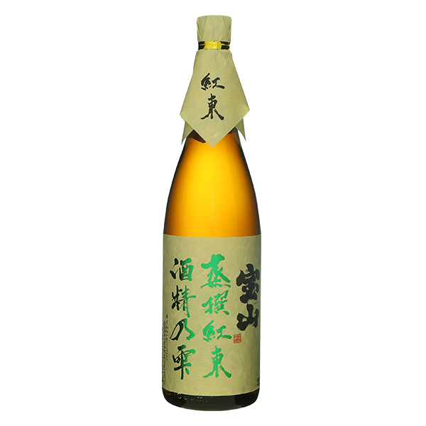
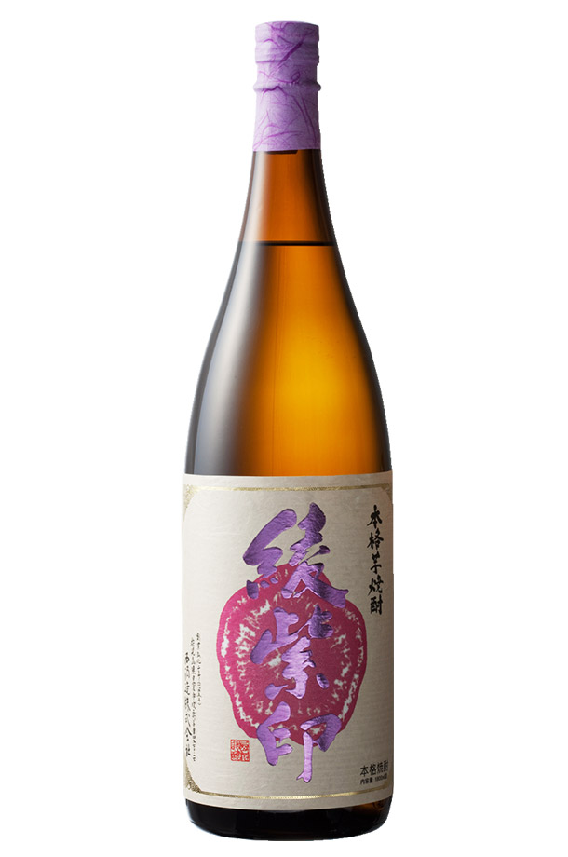
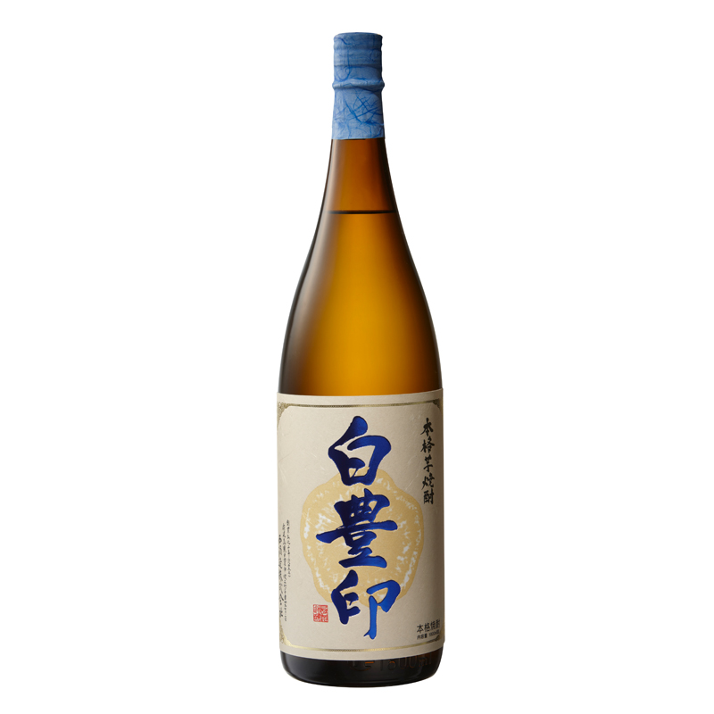
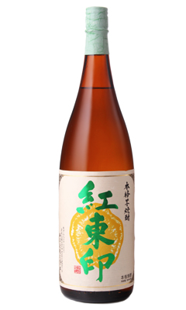
表面2
Shochu
Houzan Benai azuma
Aya murasaki shirushi
The mouth is dry and light. When you take a bite, the sweetness like chestnut spreads on your tongue. The cultivar systematically uses "Red East" whose father is Kogane sengan. Roasted sweet potatoes and sweet potatoes are also delicious. Please enjoy the unique aroma and rich aftertaste of this potato.
・ Alcohol content / 25 degrees ・ Ingredient name / Sweet potato (Red East from Kagoshima Prefecture) ・ Rice Jiuqu (White Jiuqu / Domestic rice) ・ Specifications / No filtration / No adjustment Direct packing ・ Contents / 1800ml ・ 720ml ・ Distillation method / atmospheric pressure single distillation <Seasonal>
The gorgeous and bewitching scent of the original sake is retained, but by lowering the frequency, the taste that makes it easier to drink and feels familiar is the sweetness and umami that makes you feel the width while being light, and the refreshing aftertaste makes you feel comfortable and intoxicated. invite.
The steaming series emphasizes enjoying as a single sake, but this is a shochu that you can easily enjoy the difference between potatoes with meals.
・ Alcohol content / 25 degrees
・ Ingredient name / Sweet potato (Aya murasaki from Kagoshima prefecture), Rice Jiuqu (Domestic rice)
・ Contents / 1800ml ・ 720ml
・ Distillation method / No filtration, no adjustment direct packing
★ 2011 Monde Selection Gold Award
Shiroyutaka shirushi
Beni azuma shirushi
The refreshing and sweet scent of the original sake stimulates the nasal cavity more lightly and comfortably, and by lowering the frequency, the taste that is easier to drink and feels familiar is light but milky sweetness and a little lighter. The lingering sound that makes you feel the thickness of is impressive. The steaming series focuses on enjoying the sake as a single substance, but this is a shochu that you can easily enjoy the difference between potatoes with meals.
・ Alcohol content / 20 degrees
・ Ingredients: Sweet potato (Shiroyutaka from Kagoshima prefecture), Rice Jiuqu (domestic rice)
・ Contents / 1800ml ・ 720ml
It is a pale orange flesh, has a very good taste, and is brewed using "Beniazuma", which is delicious even with roasted sweet potatoes. Although it has a dry taste, it has a sweet taste like chestnut if you include a bite. And you can enjoy the scent and finish of aromatic potatoes.
・ Alcohol content / 25 degrees
・ Ingredient name / Sweet potato (Benizuma from Kagoshima prefecture), Rice Jiuqu (Domestic rice)
・ Contents / 1800ml ・ 720ml
・ Distillation method / No filtration, no adjustment direct packing
★ 2011 Monde Selection Silver Award

Slide 8
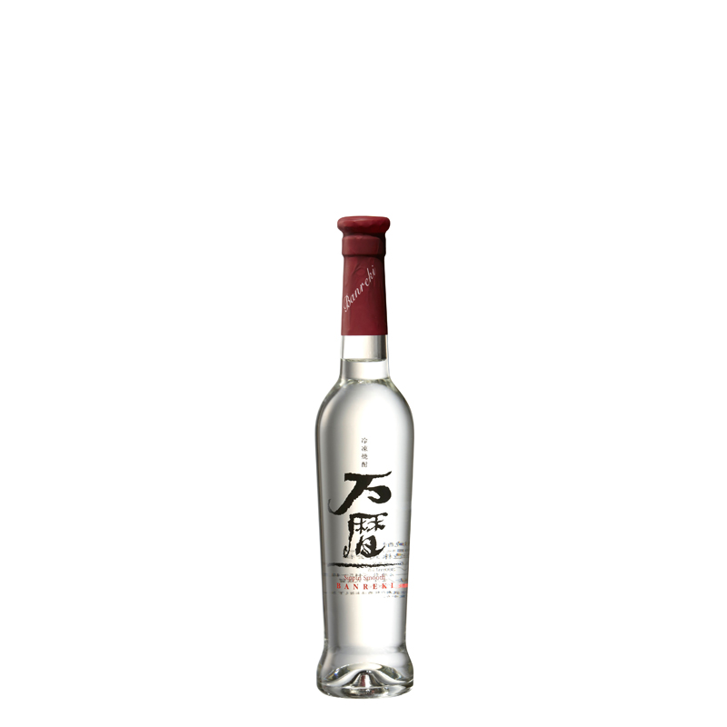
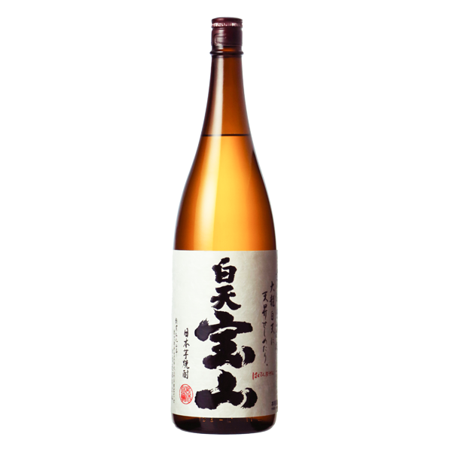
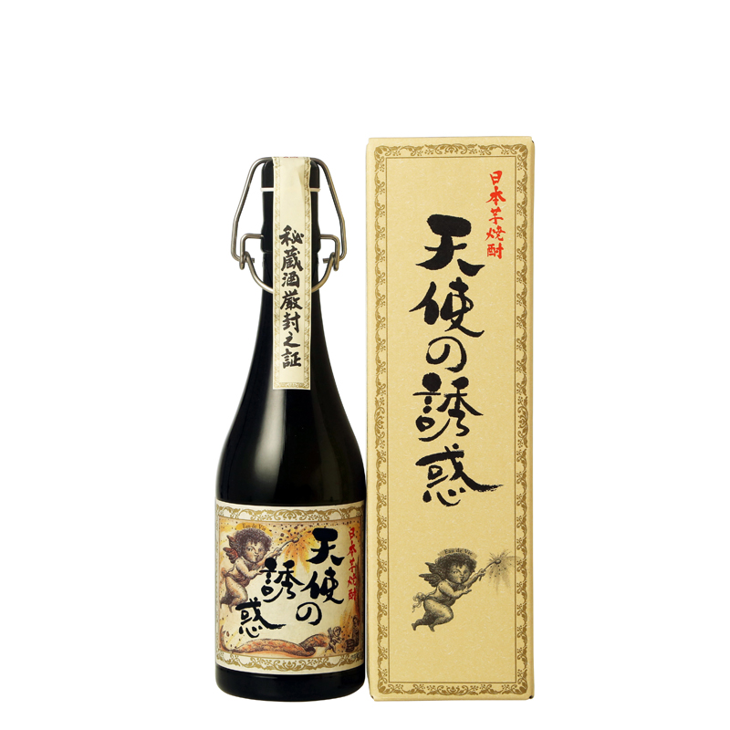
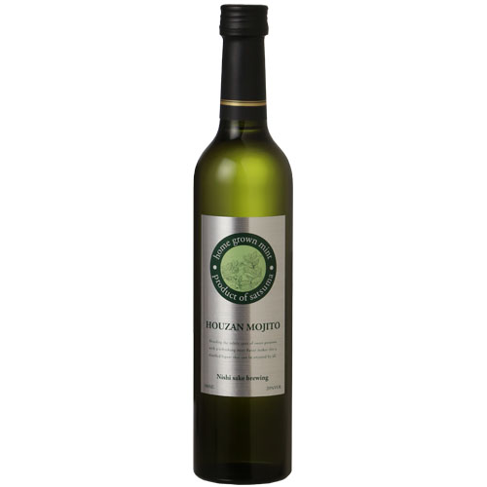
表面2
Shochu
Hakuten Houzan
Banreki
Prepared with white jiuqu. You can enjoy the dry sharpness and the soft sweetness that you feel when you roll it on your tongue at the same time. It is one that is particular about clarifying the goodness of white jiuqu preparation. It is also fun to taste the difference in Jiuqu compared to drinking it with Kichichohozan.
・ Alcohol content / 25 degrees ・ Ingredient name / Sweet potato (Kogane sengan from Kagoshima prefecture) ・ Rice Jiuqu (White Jiuqu / Domestic rice) ・ Contents / 1800ml ・ Distillation method / atmospheric pressure single distillation <Seasonal>
Distilled mash using self-cultivated yeast, scooped out the thick raw liquor that has just dripping, and the most condensed taste of potatoes in a bottle. It is a proposal as frozen shochu. A faint peach scent, a rich yet light taste. Please enjoy it by chilling it in the freezer.
・ Alcohol content / 44.5-44.9 degrees
・ Ingredient name / Sweet potato (Kagoshima prefecture Kogane sengan) ・ Rice koji (domestic rice)
・ Contents / 360ml
・ Distillation method / atmospheric pressure single distillation <Seasonal>
Tenshi no Yuuwaku
Houzan Mojito
Light amber color. However, the subtle sweetness and the refined umami that remains behind are certainly the characteristics of potatoes. We have mastered the potential of potatoes in the direction of aging. The long flow of time has brought up the scent of potatoes deeper and more vividly. It is a taste of expanding the place where shochu can be drunk, even though it is shochu, such as sticking to a glass for drinking at a special time.
・ Alcohol content / 40 degrees ・ Ingredient name / Sweet potato (Kagoshima prefecture Kogane sengan) ・ Rice koji (domestic rice) ・ Contents / 720ml <Seasonal>
★One of TWSC 2020’s Superior Gold winners in the shochu division.
Mintha was added to the potato mash and distilled.
You can enjoy the rich mint scent as it is,
Enjoy to your liking, such as adding carbonic acid or mint
Please.
・ Alcohol content / 20 degrees
・ Ingredient name / Sweet potato (Kagoshima prefecture Kogane sengan), rice jiuqu, mint. ・ Contents / 500ml

Slide 9
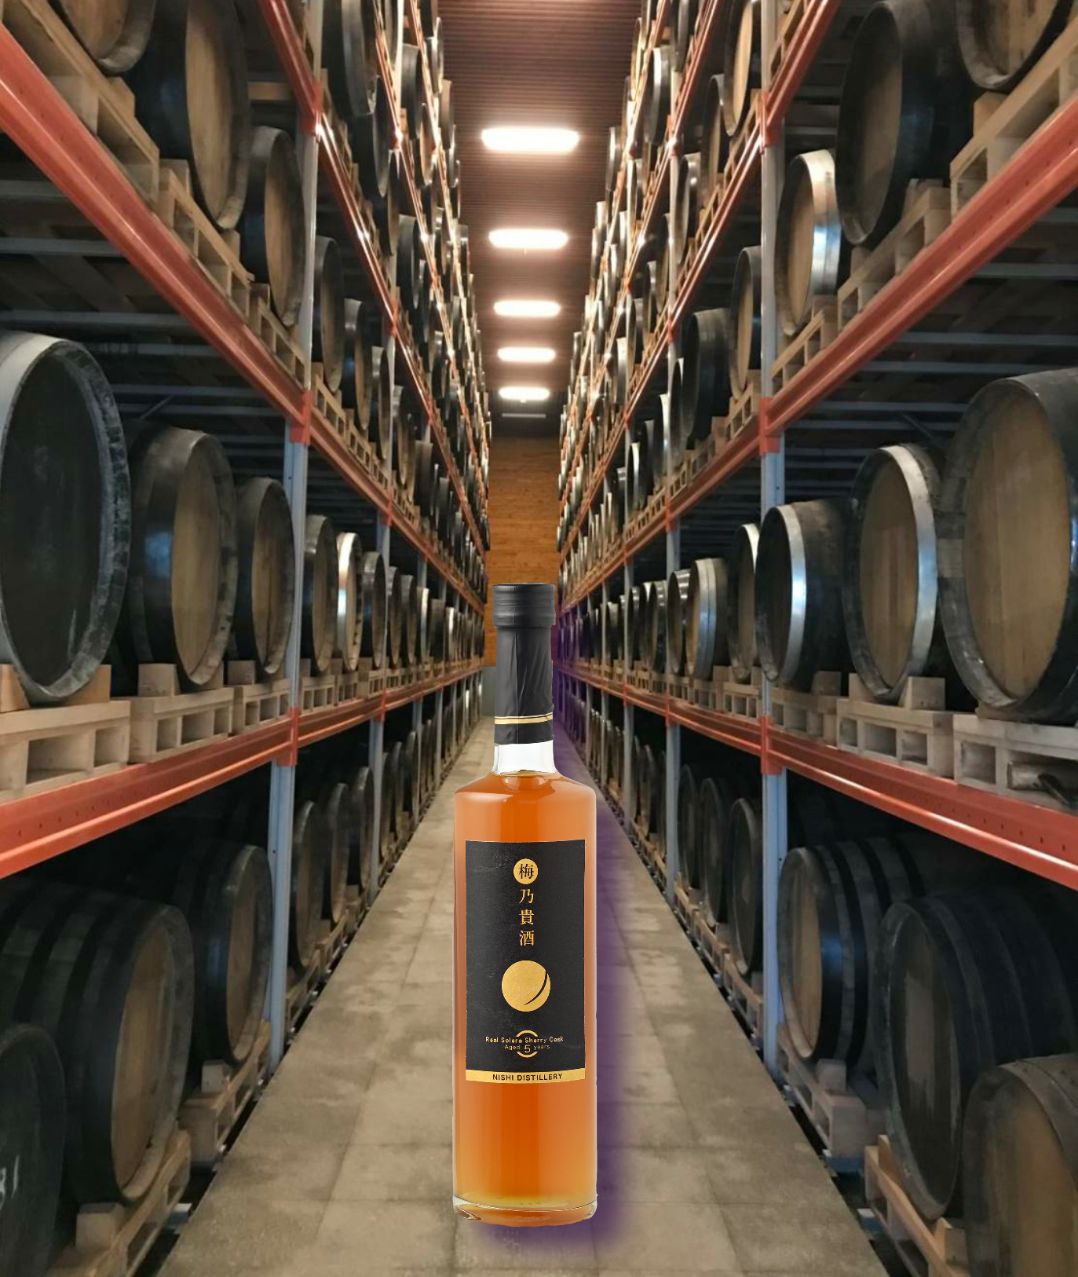
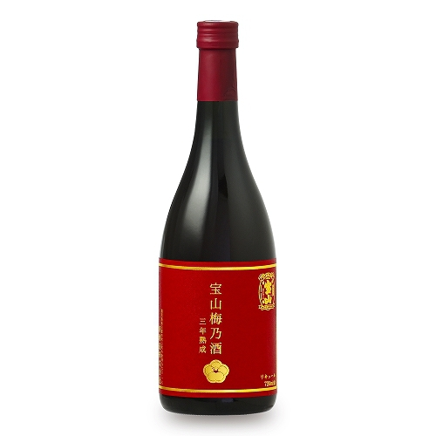
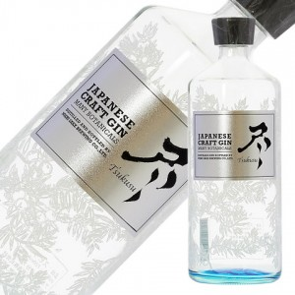
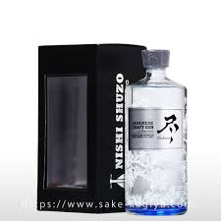
表面2
Shochu
Ume no kisyu
Ume no sake
The scent is a gorgeous fragrance derived from real Ororoso sherry barrels, dried fruits, vanilla and ginger, plums derived from special grade plum wine, and honey-like scents that spread over and over again. The taste is moist and has a rich taste of dried fruits, spices and plums. The ultimate in sweetness that you want to taste forever. The lingering sound is forever rich. World's first release! !! Natural'boke's and turbidity are handmade proofs, delicious proofs, and above all, genuine proofs.
・ Alcohol content / 12 degrees ・ Ingredient name / shochu, plum, sugar ・ Contents / 500ml
An authentic plum wine with a smooth mouth, a mellow aroma, and the plumpness of aging. Rock straight is recommended. Satsuma Takarayama's original sake is made from Kagoshima prefecture's potatoes (Kogane sengan) and rice (white jiuqu), as well as the underground water of the Takamine Mountains in Fukiage Town, "the blessings of the earth in Kagoshima", and the plums are hand-packed one by one. Uses large domestic plums. .
・ Alcohol content / 12 degrees
・ Ingredient name / Authentic shochu, plum, sugar
・ Contents / 720ml
Gin
Graft Gin～tsukusu～
Graft Gin exhausted-boxed
By selecting a botanical that maximizes the scent of juniper berries and carefully examining the pickling, we have found an exquisite balance. Domestic citrus fruits contain a lot of scent components in the skin, so after harvesting and processing during the season, they are immediately frozen to trap the scent components.
・ Alcohol content / 47 degrees
・ Ingredient name / Authentic shochu, plum, sugar
・ Contents / 720ml
By selecting a botanical that maximizes the scent of juniper berries and carefully examining the pickling, we have found an exquisite balance. Domestic citrus fruits contain a lot of scent components in the skin, so after harvesting and processing during the season, they are immediately frozen to trap the scent components.
・ Alcohol content / 47 degrees
・ Ingredient name / Authentic shochu, plum, sugar
・ Contents / 720ml
★ Boxes (Hako)

Slide 10
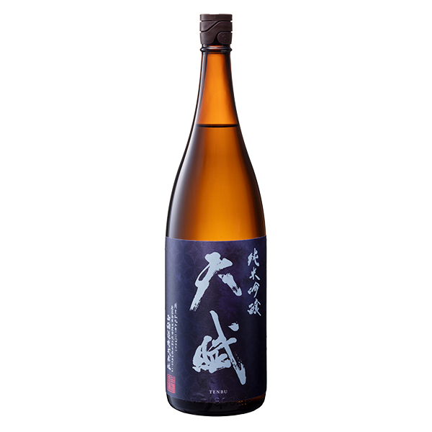
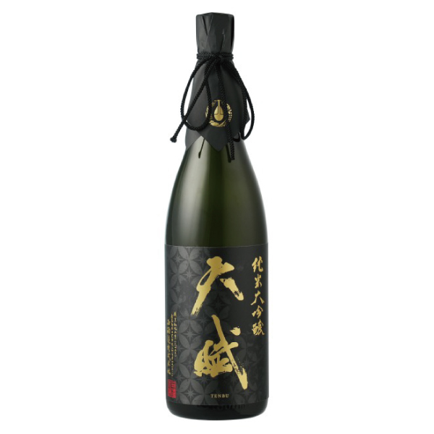
表面2
Sake
Tenbu Junmaiginjo
"Aiming for sake during meals" While fully drawing out the umami of rice, "sweetness, spiciness, acidity, bitterness, astringency" are integrated into a soft-tasting meal that expresses a harmonious and seamless finish. It is sake.
・ Raw material name / rice (domestic), rice jiuqu (domestic rice)
・ Rice polishing rate / 50% ・ Uses 100% raw rice / domestic rice ・ Alcohol content / 15 degrees ・ Contents / 1800ml, 720ml ・ Item / Sake ・ Specific name / Junmai Ginjo Sake
Sake
Tenbu Junmaidaiginjo
Junmai Daiginjo sake made from "Yamada Nishiki" from Shobudani, Tojo district, Hyogo prefecture.
Pear sorbet, acacia flowers and a hint of chervil scent bring a refreshing sensation. It has a very smooth mouthfeel, and the sweetness and umami of high-quality rice is well-balanced with the acidity, is permeable overall, and has a transparent taste like natural water.
・ Raw material name / rice (domestic), rice jiuqu (domestic rice)
・ Rice polishing rate / 35%
・ Uses 100% raw rice / domestic rice
・ Alcohol content / 15 degrees
・ Contents / 1800ml, 720ml
・ Item / Sake
・ Specific name / Junmai Daiginjo Sake

Slide 11
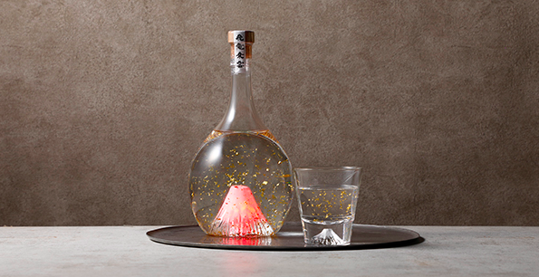
表面2
JAPANESE SAKE ART
西酒造株式会社
Fuji no Sake - Hiryujoun Junmai Daiginjo
Fuji no Sake - Hiryujoun Rice Shochu
*LED that changes color

Slide 12
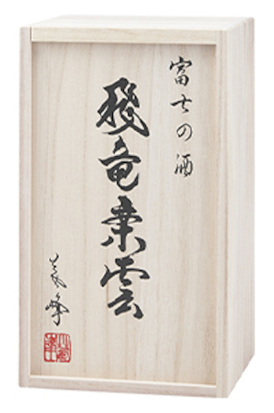
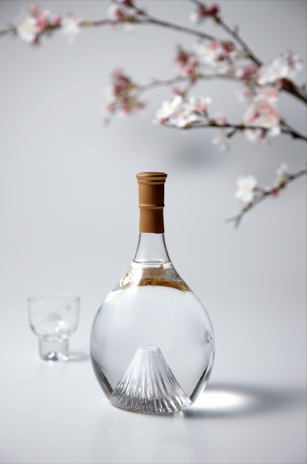
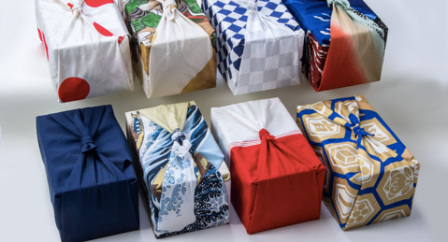
表面2
*Furoshiki (wrapping) are all carefully selected.

Slide 13
表面2
It is created with the idea of "I want to express Mt. Fuji in the best possible way and live a magnificent life like Mt. Fuji for people”
Sake is made by a brewery which is founded in 1688, the oldest brewery in Shizuoka Prefecture with 18 generations of history.
Underground water that has flowed through the lava of Mt. Fuji for over 70 years is brewed as water, and it has a high aroma and a perfect balance of sweetness and acidity. Starting with bottles handmade by blown glass craftsmen, Gold leaf, LEDs, Paulownia boxes, and Furoshiki (wrapping) are all carefully selected.
Fuji no Sake - Hiryujoun Junmai Daiginjo
Junmai Daiginjo with a high aroma, a slight sweetness, and an emphasis on the balance with acidity.
In 2004, it won the first prize or the gold medal at all the appraisals, including "Shizuoka prefecture", "Tokai 4 prefectures", and "nationwide", and even won the prestigious triple crown.
・ Alcohol content / 15-16 degrees / Sake degree: +4 / Acidity: 1.3 / Rice polishing rate: 40% ・ Ingredient name / Sake rice: Omachi ・ Contents / 900ml
Fuji no Sake - Hiryujoun Rice Shochu
Authentic Shochu is made from lees, which is unique to Japanese sake breweries with a gentle texture derived from underground water from Mt. Fuji.
In addition, the taste has no habit and is characterized by a scent that is slightly reminiscent of sake. You can enjoy it in various ways such as rock and hot water, but it is a gem that you should definitely try straight.
・ Alcohol content / 25 degrees ・ Ingredient name / Sake rice: Koshihikari ・ Contents / 900ml

Slide 14
裏面
Check it out! New product information with FB group
製品仕様
You can also have an owner's cask 🥃
JAPANESE WHISKY Perched atop a mountain overlooking Kagoshima City, Kagoshima Bay, and Sakurajima, The Ontake Distillery offers one of the nicest panoramas you’ll ever see from a whisky distillery. This highly exclusive distillery began operation in December 2019
Owner name | TORANOMON CORP
Edition | Lot No.567
Filled in | 1 Apr. 2022
Distillery | THE ONTAKE
Look at it!
Information on tours to become a cask owner Buyers doing business with us can take a local tour to become a cask owner. The name “Ontake” collectively refers to the three tallest peaks of Sakurajima: Kitadake, Nakadake, and Minamidake.
Contact information
～Connect hearts with each other～
TORANOMON Corporation
R402 BA, 4F Q-Plaza Shinjuku 3-chome 3-5-6 Shinjuku, Shinjuku-city Tokyo, 160-0022, Japan
TEL
+813 6403 5601
Reception hours 10: 00-16: 00 JST
E-mail: contact@toranomoncorp.com
Website: https://www.toranomoncorp.com
©️2022 TORANOMON Corporation. All Rights Reserved.

